Slide 1
Financial Module

Slide 2
Features
Manage Master Data
Funds
Item Accounts (Revenue, Payable, Non-Revenue)
Banks
Bank Accounts
Manage GL Accounts
SRE
NGAS
PPSAS
Manage Account Mapping
Manage Income Targets
Reports

Slide 3
Roles
FINANCIAL.MASTER
FINANCIAL.REPORT
FINANCIAL.ADMIN

Slide 4
Master Data
Fund
Item Account
Bank
Bank Account
REQUIRED ROLE:
FINANCIAL.MASTER

Slide 5
Fund
Support for Standard Funds
GENERAL
TRUST
SEF
Support Special Funds
Location:
“Main Menu-> Master-> Financial-> Funds”

Slide 6
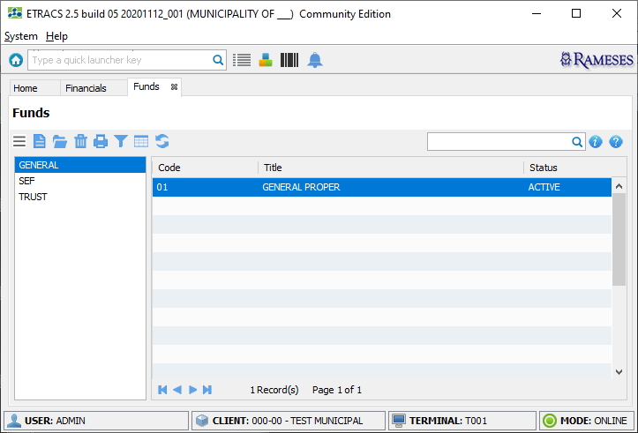
Funds Screen

Slide 7
Item Account
Refers to the revenue/payable item accounts
Printed on the receipt
Must be specific
Police Clearance (Local)
Police Clearance (Abroad)
Must be mapped to GL Accounts to generate report
Location:
“Main Menu-> Master-> Financial-> Item Accounts”

Slide 8
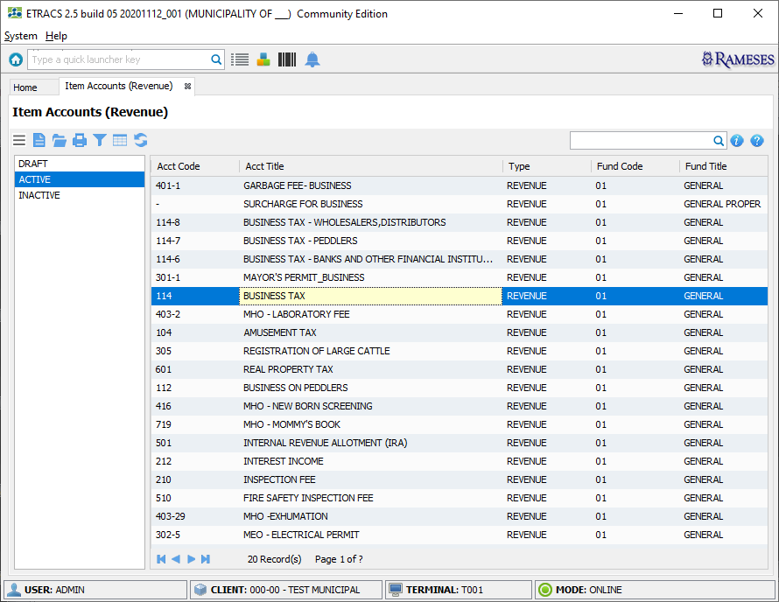
Item Accounts Screen

Slide 9
Creating an Item Account
Click icon to create a new record
Fill-in the required fields that marked with (*)
Click icon to save information
Click the “Activate” button to make the account active
Repeat Step-1 if you want to create another record
Click icon to close the screen

Slide 10
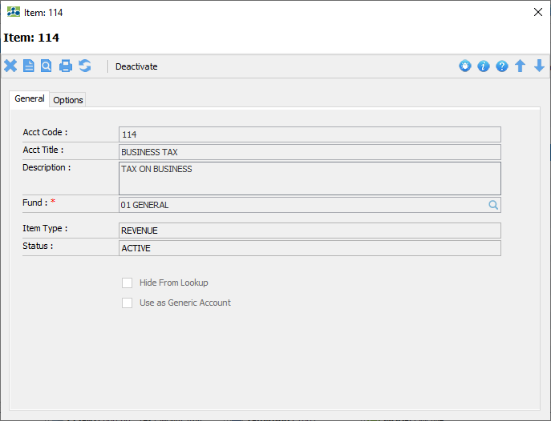
Item Account Screen

Slide 11
Bank
Depository banks
Check banks
Location:
“Main Menu-> Master-> Financial-> Banks”

Slide 12
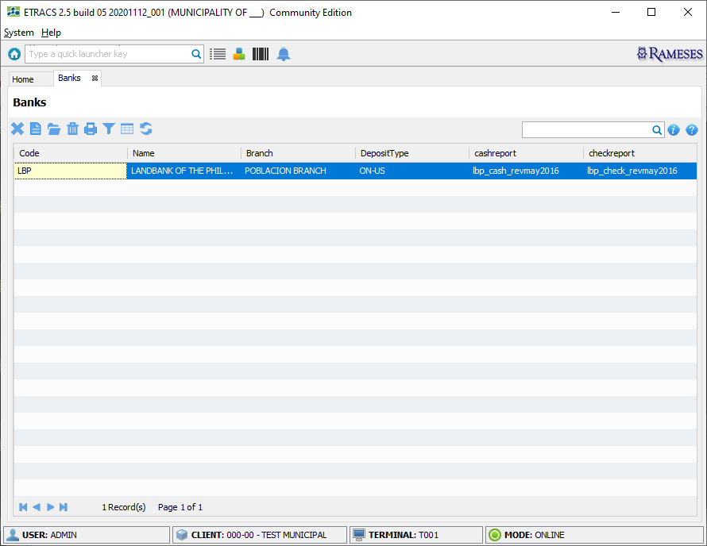
Banks Screen

Slide 13
Creating a Bank
Click icon to create a new record
Fill-in the required fields that marked with (*)
If marked as “Depository Bank”, please specify the deposit slip handlers
Click icon to save information
Repeat Step-1 if you want to create another record
Click icon to close the screen

Slide 14
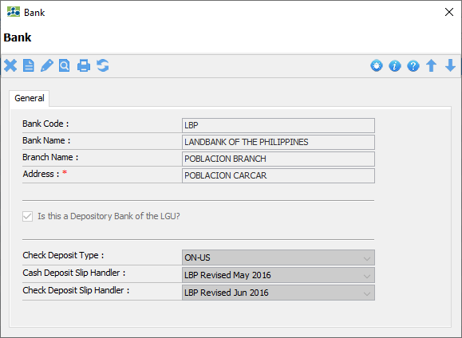
Bank Screen

Slide 15
Bank Accounts
Depository bank accounts
Location:
“Main Menu-> Master-> Financial-> Bank Accounts”

Slide 16
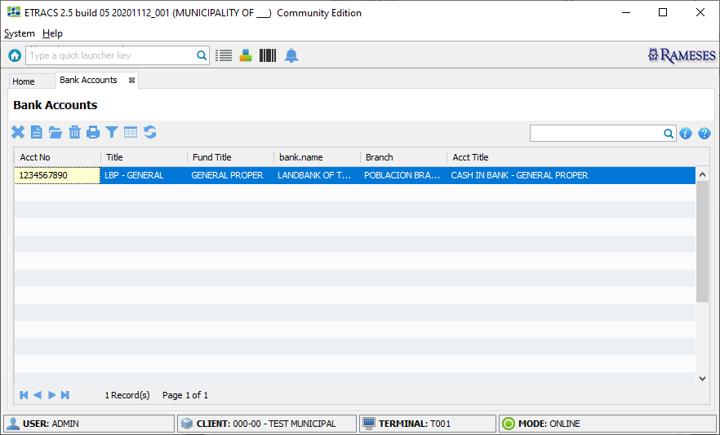
Bank Accounts Screen

Slide 17
Creating a Bank Account
Click icon to create a new record
Fill-in the required fields that marked with (*)
Click icon to save information
Repeat Step-1 if you want to create another record
Click icon to close the screen

Slide 18
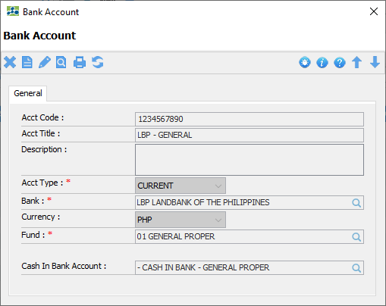
Bank Account Screen

Slide 19
GL Account
Create, Update and Delete Account
System Defined Groups
SRE
NGAS
PPSAS
Location:
“Home-> Financials-> Account Master”

Slide 20
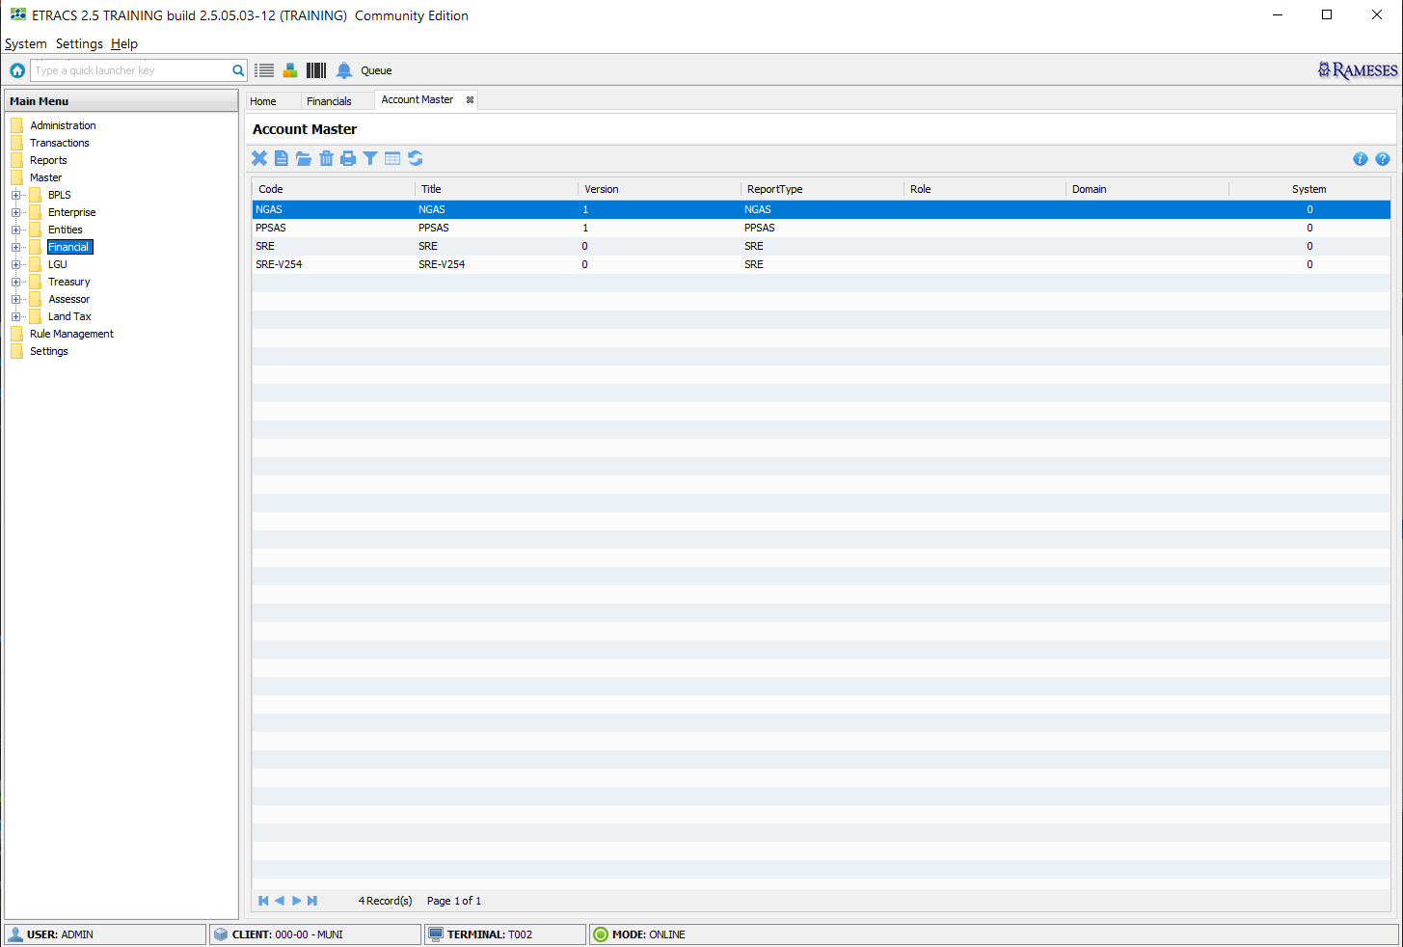
Manage Account Master Screen

Slide 21
GL Account Mapping
Allow Item Accounts to be mapped to any GL Accounts
This is a requirement in generating reports like Statement of Receipt Sources, Statement of Revenue, JEV, etc…
Location:
“Home-> Financials-> Account Mapping”

Slide 22
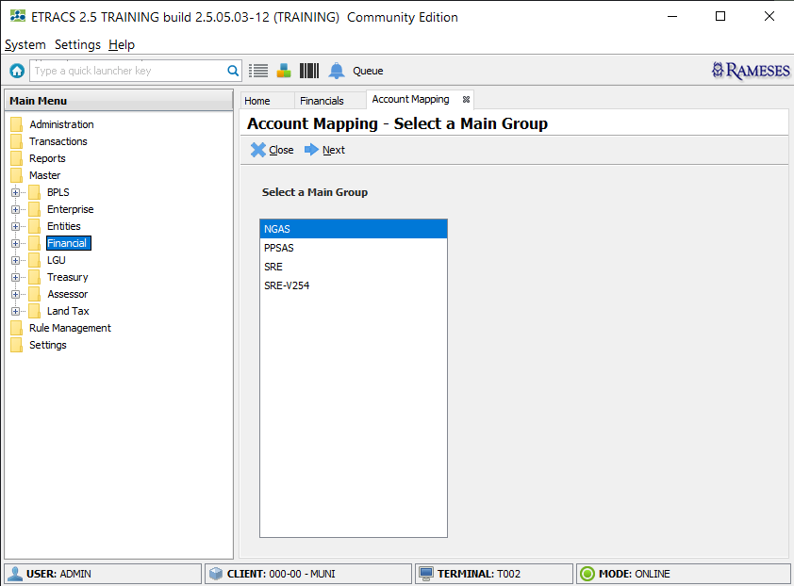
Manage Account Mapping Screen

Slide 23
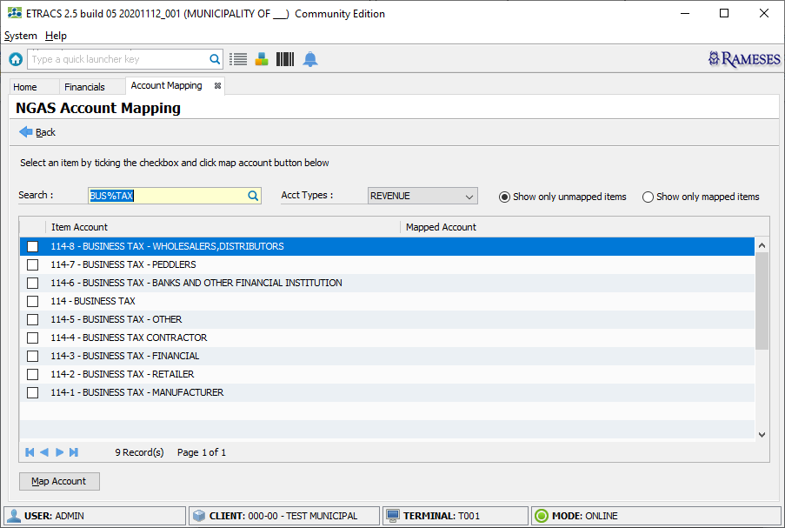
Manage Account Mapping Screen

